Slide 1
Links for Interactive Sessions Sign up for free accounts to follow along
Sign up for Spark for Free Sign up here: http://web.ciscospark.com
Send us a message at brbester@cisco.com
Tropo Site: https://www.tropo.com/
Learning Lab:https://learninglabs.cisco.com/lab/tropo-intro/step/1
IFTTT: https://ifttt.com/recipes
Built.io: https://www.built.io/
Notes:
And that’s the challenge that Tropo solved.
The Tropo® solution provides cloud-based APIs that make it easy to add real-time communications to new or existing business applications and processes. No software to install, no up-front costs, no maintenance. In just minutes, a developer can create a Tropo.com app to do things like make or receive calls and text messages, transfer calls, and set up conferences.
With Tropo, communication starts and stops right when you need it to, does and says what you tell it to, and lives in the places your users and customers already are.

Slide 2
Cisco On The Road
Collaboration: Power Apps through Spark APIs
Atlanta Session
Brad Bester
September 2016

Slide 3
AGENDA
Introduction & Overview – 15 Minutes
Tropo API Interactive – 25 Minutes
Spark API Interactive – 25 Minutes
Additional Resources & Questions – 10 Minutes

Slide 4
Introduction and Overview
Notes:
Casey Bleeker

Slide 5

…“The core competency for Collab Specialists is shifting from telephony and networking, towards software skills such as API's and integrations”…
Jonathan Rosenberg VP.CTO CTG
Notes:
KEY message – will repeat 3 times
MESSAGE: Going forward, the core competency of Collaboration specialists is shifting from telephony and networking skills towards SOFTWARE skills such as APIs and Integrations.
The video message from Jonathan Rosenberg clearly articulated the importance for our future

Slide 6
Why are APIs Important?
Speed to Market
Cloud APIs allow companies to rapidly meet the demands of their users.
Size doesn’t matter. Companies of all sizes can innovate and share their value.
Agility
Data and functionality can be composed and reused in different ways to fill portfolio gaps, and do what no one else can.
Flexibility
Monetizing Core Value
Companies can package and expose their core services more easily.
Notes:
SPEED TO MARKET: allowing customers to deliver services faster
AGILITY: size doesn’t matter, no kingdoms & islands of technology to build services. grab existing services and leverage those to built your service. That’s why you see a lot of small companies disrupting the market, because their services are easy to embed & use.
FLEXIBILITY: when you have these different services, use mapping+location+communication+payment services and compose them in different ways to meet the needs of different user groups. No need for custom development.
MONETIZING CORE VALUE: a lot of customers say “collab is not my core business” just like voice/video services and contact centers.. They’re right! In Finance, the core service is not interaction with customers.. That’s our core business. They don’t want to worry about the capabilities. They CAN “consume” the non-core-business services, adding these to their core-business applications.
Business reconsider going to market..

Slide 7







How Cloud APIs are silently disrupting our Experience…
Notes:
Think about that
I go online, purchase things, browse the web and see integration between services, I interact with devices around me..
I have things like sharing content of websites into Facebook. Sign into services not with individual logins but sign in with Google. Single identities.
I buy things at Amazon etc. No Creditcards but just using Paypal.
Even with devices. Single experience.. It feels natural. We get used to that.
The disruptor: if you deal with an enterprise being a customer you expect a similar experience.
We’re not going to compare our experience to Alcatel, Microsoft or Slack, no, we’re going to compare it to the best experiences out there..
… for my identity, services, etc.
We have to make sure we understand what the best experience is.

Slide 8








Who Uses the Integrations and APIs?
Native Integration’s
App Integration services
Power User
-
/Webhooks
/Rooms
/People
/Messages
/Memberships
Developer

Slide 9
Cisco Collaboration Evolution
Provide a platform for building custom solutions
Digitize Your Business
Deliver the best
of both worlds
Create ubiquitous
appeal to
ensure adoption
Accelerate Innovation with Hybrid
Agility
Unify
communication
foundation
Enhance productivity with
cost reduction
Enable Simple & Seamless
Experiences Experiences
Converge Voice, Video, & Data
Simplify Collaboration Infrastructure
PAST
FUTURE

Slide 10
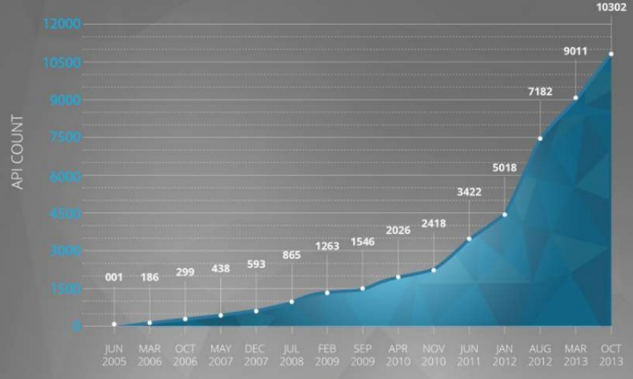
Services with APIs: Growth Since 2005
30,000
2006 - 186
2008 - 865
2010 – 2,026
2012 – 5,018
2013 – 9,011
2016 –30,011
2016
Source: Programmable Web research 2013+2015

Slide 11







How Many API calls?
A P I .
350 billion/day ²⁰¹⁵
²⁰¹²
40 billion/day ²⁰¹³
80% of their transactions
15 billion/day ²⁰¹²
A P I .
5 billion/day ²⁰¹²
²⁰¹²
60% of their listings
5 billion/day ²⁰¹⁵
Notes:
LATEST NUMBERS? Couldn’t find them..
80% of Salesforce transactions go through their API (2012)
60% of all Ebay listings are added via their API (2012)
FACEBOOK numbers: http://www.android100.org/html/201509/22/183615.html
AMAZON AWS numbers 2015: http://www.slideshare.net/AmazonWebServices/arc346-scaling-to-25-billion-daily-requests-within-3-months-on-aws
THIS presentation shows higher numbers: http://www.slideshare.net/jaquayle/making-telecoms-the-essential-spice-of-every-business-ecosystem-the-slow-painful-rise-of-apis-in-telecoms
19B /day Facebook (Dec 2011)
14B /day Twitter (Nov 2011)
11B /day Google (Feb 2012)
28B /month Netflix (Jan 2012)
12B /month Ebay (Dec 2011)

Slide 12

Collaboration & API’s? Guess What..
Meeting Center
MX video
CC Express
UC Express services
Training Center
DX video
CC Enterprise
UC GW svcs
Support Center
HCS
CVP
UCM SIP
Event Center
Interact.Exp.Platf
Express CTI/config
Webdialer
Webex Meetings
Jabber Guest
Express Scripting
U.GW API
Messenger
Jabber web
Finesse
Spark
Unity
Socialminer
And more…
Tropo
Prime
Mediasense
SX codecs
Jabber acc.
CC reporting
C-video endpoints
Presence API
(J)TAPI
Notes:
SO that’s all great… however… What is Cisco’s role in API world?
What do you think about API’s in collaboration? Which products have API’s?

Slide 13
The New Collaboration Landscape Powered by APIs that are simple, open, and pay as you go
-
-
Embed a collaboration service into your offering
Access your favorite tools wherever you work
Build customized solutions for verticals
Integrate with your existing IT management tools
Results
Accelerate time to market
Generate better business outcomes
Improve employee satisfaction
13
Notes:
Collaboration is shifting from linear, rigid, proprietary systems to open, flexible, and fast cloud-based platforms. This shift is enabling developers to integrate services in a way that dramatically improves service innovation and utility, thus speeding up time to market, improving business outcomes, and enhancing employee satisfaction. Users benefit from seamless connections between collaboration services and the applications relevant to their function, vertical and personal preference.
Ask: does this sound consistent with your experiences? If not, why?

Slide 14
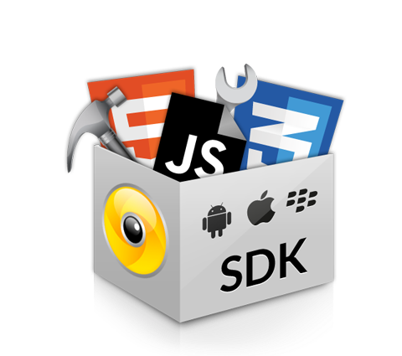
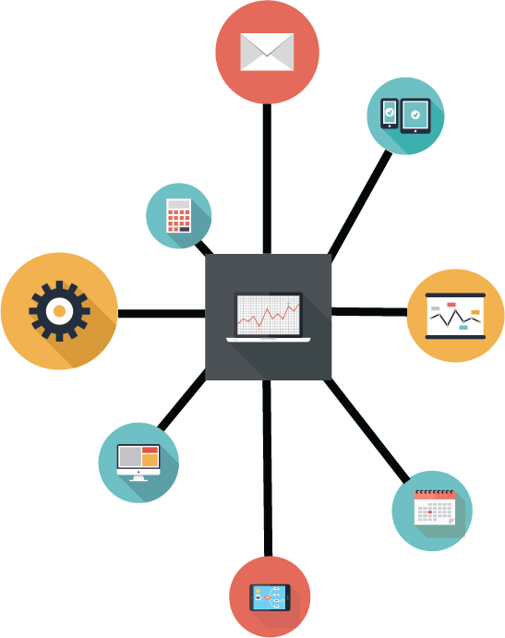

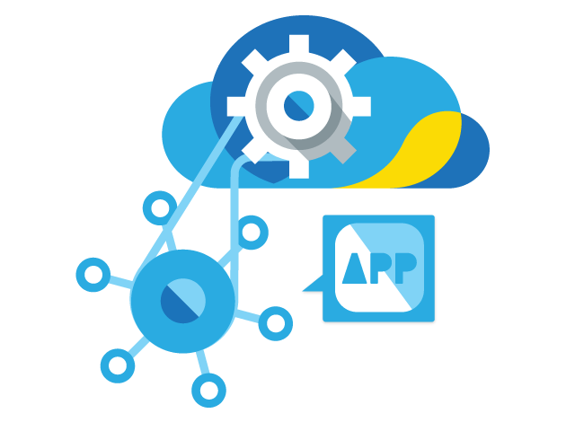

Spark Platform API Fundamentals
Which users do we consider Spark ‘developers’?
Integrations
Webhooks
APIs
SDK

Slide 15


Cisco Collaboration Cloud APIs
The Solution
Our flexible platforms offer a comprehensive set of tools to extend and embed cloud collaboration services. →Team productivity and deeper customer engagement.
Integrate, extend, and customize Spark experiences
Tropo Platform
Cisco Spark Platform
Embed voice and SMS services to enhance business processes
Complete collaboration solution
Connect people, services and business processes like never before
Modular building blocks
15

Slide 16
APIs

Slide 17

Webhooks

Slide 18
Integrations (Pre-packaged)

Slide 19
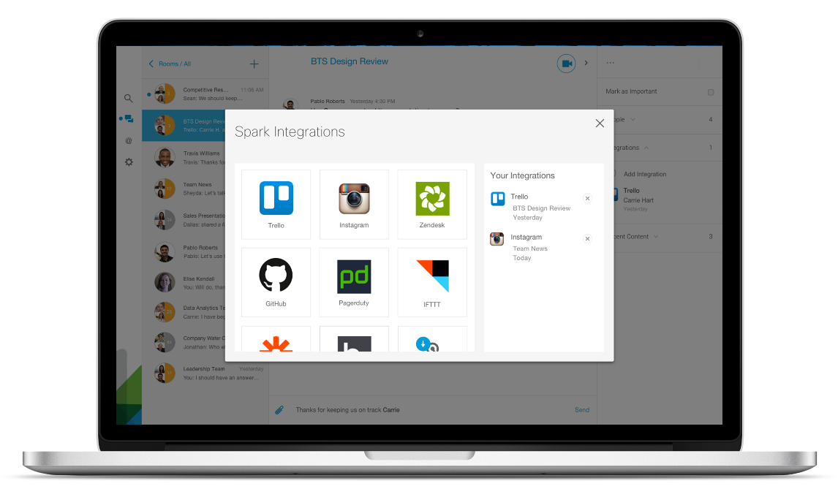
Use Native Integrations or Create Your Own
Unify workstreams from right inside the Cisco Spark app with native integrations
Trello, Pagerduty, Zendesk, Github
Screens are for marketing use only and may change in production
Notes:
Initial native integrations- services like:
Github
Instagram
Pagerduty
Trello
Zendesk
More to come!
Don’t see your app listed in our catalog? Well, we’ll be adding more so check back often. Or, use webhooks to create your own inbound and/or outbound exchanges between Cisco Spark and third-party apps
You can also go out and create your own integrations. Use app integration service platforms to build your own integrations between Cisco Spark and the other apps you love. Use built-in filters to automate how content is shared, and to enhance the utility of the integration.
Example: Create a ‘Zap’ in Zappier to have Box folders and new content posted therein share with Cisco Spark room(s).

Slide 20

App Integration Services
Platforms that create connections between hundreds of apps
Build your own integrations between Cisco Spark and the other apps you love
Use built-in filters to automate how content is shared
Notes:
App integration services help you easily configure automated connections between Cisco Spark and hundreds of other apps. Using Zapier, IFTTT, or Built.IO, you can set up integrations between Spark and utilize built-in filters so that the content exchanged is highly useful to you and your teams. (E.g. only send on certain days, exchange content between certain folders, etc.)
Example: create a ‘Zap’ to have Box folders and new content posted therein share with Cisco Spark room(s).

Slide 21
SDK

Slide 22
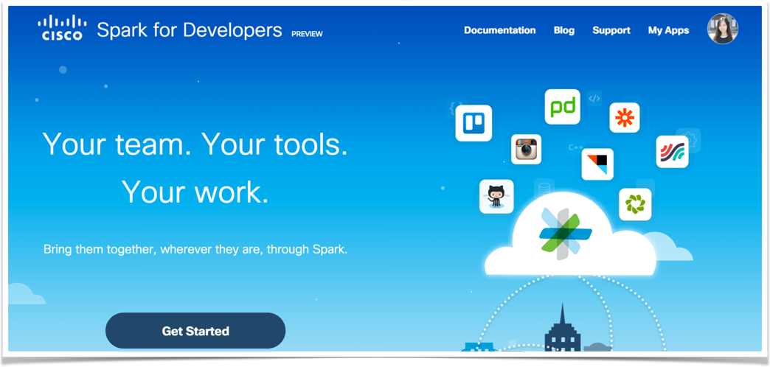
Spark for Developers
developer.ciscospark.com

Slide 23



Key API Features and Use-Cases
Rooms/People → Automating room creation and population
Messages → App-driven notifications and reports
Webhooks → Interactive chat ‘Bots’
Oauth → Custom/embedded chat messaging
TTS/Speech Recognition → Voice driven interactive customer service
SMS → Automated outbound notifications, inbound SMS apps
Recording/Transcription → Voice messaging and voice notes/records
Telephony/Conferencing → Notifications and team voice comms

Slide 24

Example: Tropo API’s
Notes:
Casey Bleeker

Slide 25

About Tropo
Cloud-based APIs: no software to install, no maintenance
Build voice and SMS applications that enhance new or existing business processes
Make or receive calls and text messages, transfer calls, set up conferences, and more
Enjoy free development – no upfront costs, only pay for what you use in production
Notes:
And that’s the challenge that Tropo solved.
The Tropo® solution provides cloud-based APIs that make it easy to add real-time communications to new or existing business applications and processes. No software to install, no up-front costs, no maintenance. In just minutes, a developer can create a Tropo.com app to do things like make or receive calls and text messages, transfer calls, and set up conferences.
With Tropo, communication starts and stops right when you need it to, does and says what you tell it to, and lives in the places your users and customers already are.

Slide 26

Included API Features
No telco expertise required: Quickly provision phone numbers and simply pay as you use them
Play audio to callers: Set prerecorded audio messages or use text-to-speech in 40+ languages and dialects
Collect caller input: Use dual-tone multifrequency (DTMF) signaling or speech recognition in 80+ languages and dialects at no additional cost
Capture the dialogue: Record part or all of a call for free, and use optional transcription capabilities
Notes:
The key benefits that stand out for Tropo users:
No telco experience or expertise required: Again, we abstract away all the complexity of the underlying network and help you focus on solving business problems using simple commands. Tropo can help you provision new numbers instantly, help you port existing numbers into your Tropo apps, or even help you dynamically provision new numbers right before an interaction in case you need to use number masking.
Our audio expertise is highly differentiated. Devs can use our text-to-speech on over 40 languages and dialects to have our computer voice say the desired text in an IVR application in a local language. Our speech recognition helps improve the effectiveness of IVR apps so that it can recognize multiple languages and dialects for a diverse user base. And call recording and transcription is available too to take real-time voice interactions and save them for future analysis.

Slide 27
Tropo API Platform Components
Global Network
Capabilities
Number Provisioning
Voice Calling
Text Messaging
Local Numbers
Toll Free Numbers
40+ countries
Monthly rental fee
Inbound
Outbound
Priced per minute
Inbound
Outbound
Priced per message
Rich
API
Advanced Call Control
Rich Media
Tropo Cloud
Transfers
Conferences
DTMF
Speech Recognition
Audio playback and text-to-speech transcription
Redundant US Data Centers
Tropo.eu
Usage based model
Notes:
Tropo offers these capabilities in a flexible pricing model along with our value added speech and recording features.

Slide 28
Links for Tropo Interactive Session
Tropo Site: https://www.tropo.com/
Tropo Lab: https://learninglabs.cisco.com/lab/tropo-intro/step/1
Pre-built Tropo bots: https://www.tropo.com/tropo-solutions/
Notes:
And that’s the challenge that Tropo solved.
The Tropo® solution provides cloud-based APIs that make it easy to add real-time communications to new or existing business applications and processes. No software to install, no up-front costs, no maintenance. In just minutes, a developer can create a Tropo.com app to do things like make or receive calls and text messages, transfer calls, and set up conferences.
With Tropo, communication starts and stops right when you need it to, does and says what you tell it to, and lives in the places your users and customers already are.

Slide 29

Example: Spark API’s

Slide 30



Integration Platform as a Service (iPaaS)

Slide 31
What Are They?
Integration Platform as a Service (iPaaS). Connects software, back-end systems, mobile apps, and even sensors and devices through a simple interface easily connecting the web apps you use, making it easy to automate tedious tasks.
Partners, ISV’s or iPaaS…
You can wait for third-party app developers to offer the SaaS integrations you need.
You can hire expensive freelance programmers to build custom software for you.
Or you can simply do it yourself with an iPaaS app!

Slide 32


iPaaS Integrations
Provides thousands of pre-built, ready-to-use activities of over 100 services.
Well-known service integrations for Spark, Tropo, and Webex include:
Salesforce, Marketo, AWS, Zendesk, GitHub, Dropbox, Wordpress, MailChimp, Pocket, Google Drive, OneNote, Fitbit, Uber, PushBullet, and many more.

Slide 33
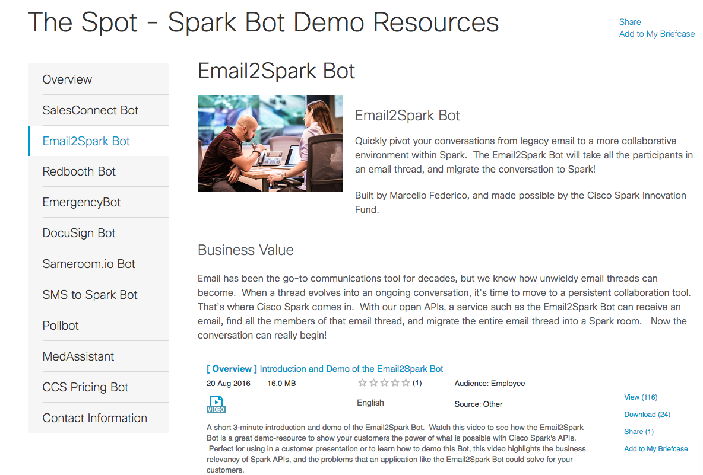
Prepackaged Bots Example – cs.co/thespot

Slide 34
Links for Spark Interactive Session
IFTTT: https://ifttt.com/recipes
Built.io: https://www.built.io/
Notes:
And that’s the challenge that Tropo solved.
The Tropo® solution provides cloud-based APIs that make it easy to add real-time communications to new or existing business applications and processes. No software to install, no up-front costs, no maintenance. In just minutes, a developer can create a Tropo.com app to do things like make or receive calls and text messages, transfer calls, and set up conferences.
With Tropo, communication starts and stops right when you need it to, does and says what you tell it to, and lives in the places your users and customers already are.

Slide 35
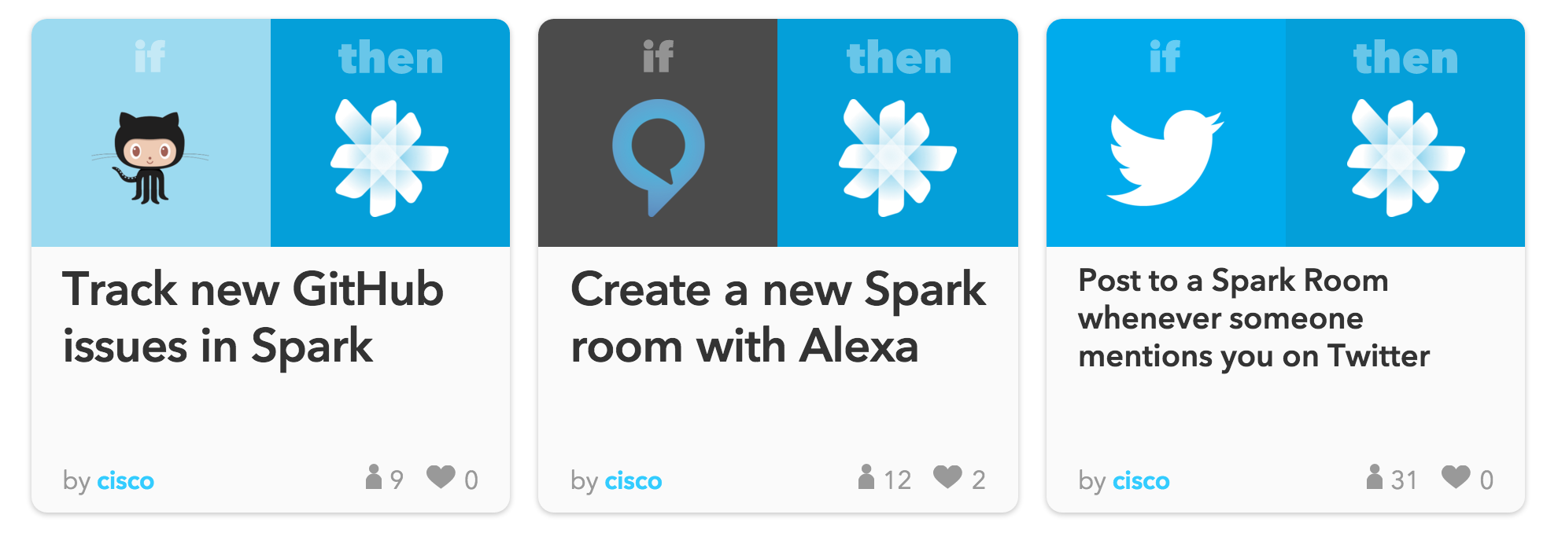
iPaaS Use Cases – IFTTT
Easily create a recipe or use one that’s already been uploaded
Anytime a particular term (#ciscospark) is tweeted, have that tweet updated in a room you designate

Slide 36
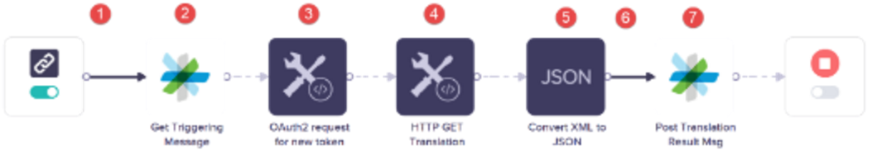
iPaaS Use Cases – Built.io
Customer Support/Translation Services: O365 email in Spanish is automatically converted to English in a Spark Room
https://developer.ciscospark.com/blog/blog-details-7569.html
SFDC: Wufoo web form is filled out, insert a record into Salesforce, create a Trello task to follow up, and insert an appointment on your Google Calendar to call the new customer.
https://www.tropo.com/2015/10/simple-enterprise-integrations-built-io-flow/

Slide 37
Additional Resources

Slide 38
Additional Resources
http://apidocs.cisco.com (Auto-Generated Collaboration Platform API Docs)
http://cto-github.cisco.com/SparkPlatformSDKs (Demo Source Code)
https://github.com/ (Github workflows)
https://developer.ciscospark.com/ (Spark for Developers)
https://zapier.com/ (Automate Workflows)
https://learninglabs.cisco.com/ (Devnet Learning Labs)
https://cisco.jiveon.com/docs/DOC-101979 (Collaboration API Resources)
https://cisco.jiveon.com/docs/DOC-24667 (Cisco WebEx APIs)

Slide 39
LINKS
Collaboration API resources https://cisco.jiveon.com/docs/DOC-101979
Webex API’s https://cisco.jiveon.com/docs/DOC-24667
Learning Labs https://learninglabs.cisco.com
Pre-built Tropo bots https://www.tropo.com/tropo-solutions/
Tropo Lab https://learninglabs.cisco.com/lab/tropo-intro/step/1

Slide 40
Continue Your Education in the DevNet Zone
Try a Spark or Tropo DevNet Learning Lab
Create Spark Rooms, Add Participants and Post Messages
Learn to create a Spark Webhook that will subscribe to new messages in a room
Register a new Spark app, and authenticate from a browser based app
4. Quickly create a Tropo app with TTS, audio file playback and outbound calling
Attend other Spark/Tropo API sessions or take an instructor-driven Workshop
DEVNET-2020: [Workshop] Working with Spark APIs
DEVNET-2021: Spark API Authentication - Bots and Oauth
DEVNET-2025: [Workshop] Build a Multi-Function iPaaS Application Using Python
DEVNET-3002: [Workshop] Tour the DevNet Quiz App (Spark & Tropo Integration)

Slide 41
Continue Your Education in the DevNet Zone
Take the DevNet « Coding Track »
DEVNET-1001: Coding 101, Introduction to REST APIs
DEVNET-1060: Intro to API Authentication Types (Oauth, token HTTP Basic)
DEVNET-1080: Introduction to Git
DEVNET-2002: Coding 102, REST API Basics using Spark
DEVNET-2003: Coding 102, REST API Basics using APIC-EM
DEVNET-2006: Coding 103, Deep Dive on JSON & more Python
Meet the Experts at the Demo Pods

Slide 42
Terminology
REST – For this discussion, the delivery of collaboration services using JSON over HTTP
Microservice – A cloud-hosted service that delivers a specific narrowly scoped capability
Endpoint – The fundamental HTTP request binding of a REST microservice (e.g. "POST /foo/1")
API – a collection of endpoints exposed by a microservice
Platform APIs – the aggregation of APIs from microservices hosted in the Spark cloud

Slide 43

















Cloud
Collaboration Platform
Tropo
Integrations
Fusion
Spark iOS Client
Spark Android Client
Spark Web Client
Customer Premise
3rd Party Clouds and Services
Cisco UC
Spark OSX Client
Spark Windows Client
Spark Windows Phone
Cisco TP
Enterprise Apps.
Bots
REST (JSON/HTTPS)
JSON/WebSocket
APNS | GCM | WMS
SIP/SRTP

Slide 44
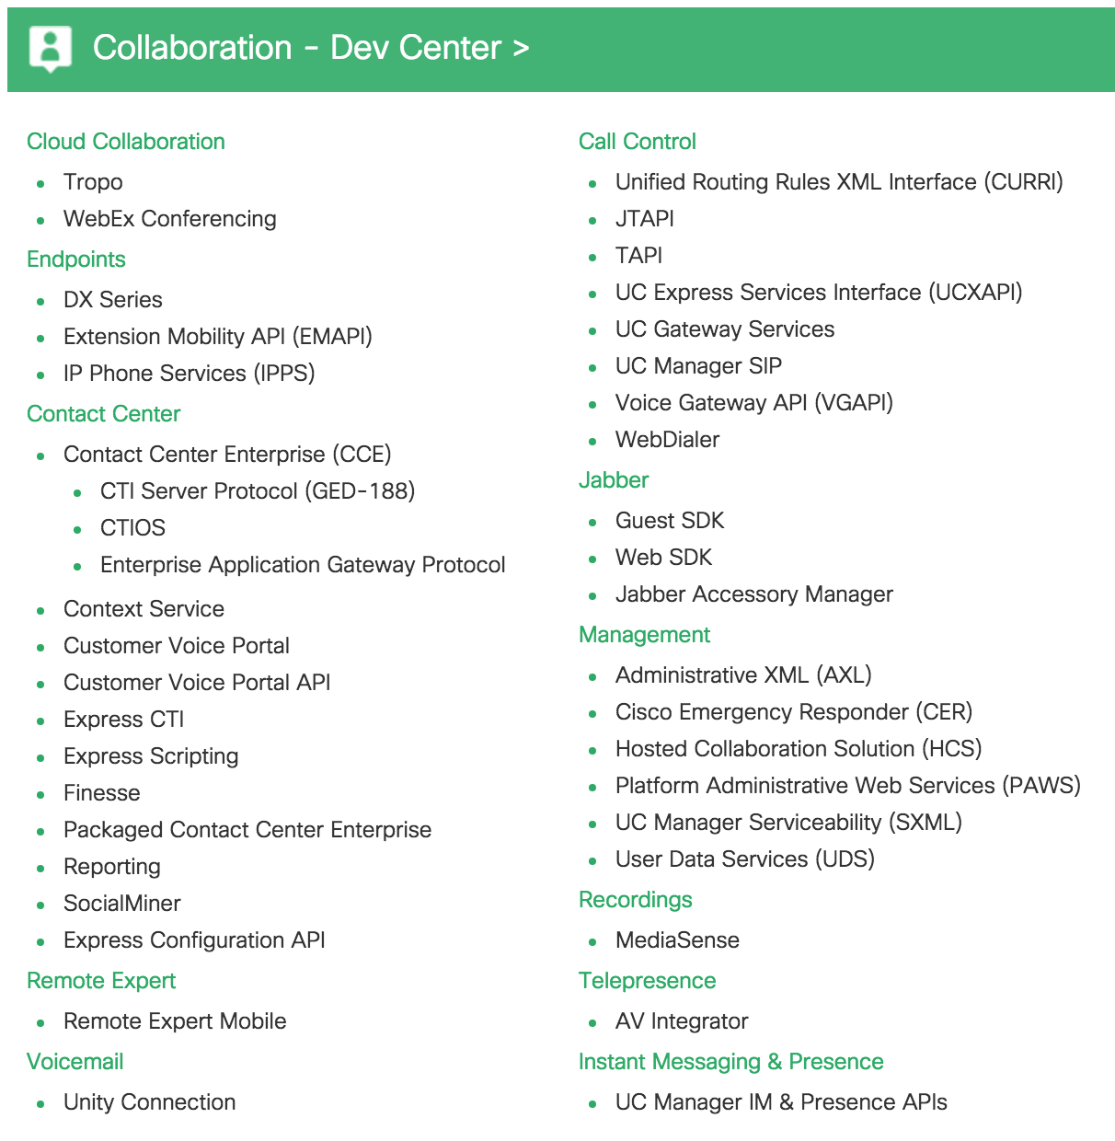

Cisco DevNet
Add URL
Documentation
Examples
Sandbox (!!)
Training

Slide 45
Learning Labs
https://learninglabs.cisco.com
Android
Beginner
CUMI
Calls
Collaboration
Intermediate
Jabber Guest
Jabber Web SDK
Javascript
Mobility
Phone
Remote Expert Mob.
Rest
SMS
TTS
Tropo
UDS
Voice
Webex Meetings API

